Slide 1
Lecture 7 – Machine Learning – Regression & Clustering
AY 2024-25

Slide 2
Lesson Outline
L7 – ML – Regression & Clustering
Regression
Clustering

Slide 3
Supervised learning
Supervised learning
Given the “right answer” for each example in the data.
map(x, y)

Slide 4
1. Regression
A type of supervised learning
A computer program predict the output for the given input
Learning algorithms typically output a function. f(x)=mx+b
Example:
Predict the claim amount of insured person
Predict the security price

Slide 5
1. Regression
Regression models are used to predict a continuous value.
Linear Regression

Slide 6
Sample Dataset
Reflect the features of attribute values in a sample dataset
The dependency between attribute values
The relationship of sample mapping through functions

Slide 7
Regression Models
Simple regression model − This is the most basic regression model in which predictions are formed from a single, univariate feature of the data.
Multiple regression model − As name implies, in this regression model the predictions are formed from multiple features of the data.

Slide 8
Linear Regression
the statistical model that analyzes the linear relationship between a dependent variable with given set of independent variables
Type of supervised learning
Simple Linear Regression algorithm (Assume that 2 variables are linearly related)
Multiple Linear Regression algorithm (predicts a response using two or more features)

Slide 9
Types of regression models
Regression Models
Simple
Linear
Non-Linear
Multiple
Linear
Non-Linear
1 feature
2+ features

Slide 10
Linear Regression
Linear regression is called simple if you are only working with one independent variable (x).
Formula: f(x)=mx+b
Cost Function
We can measure the accuracy of our linear regression algorithm using the mean squared error (MSE) cost function.
MSE measures the average squared distance between the predicted output and the actual output (label).

Slide 11
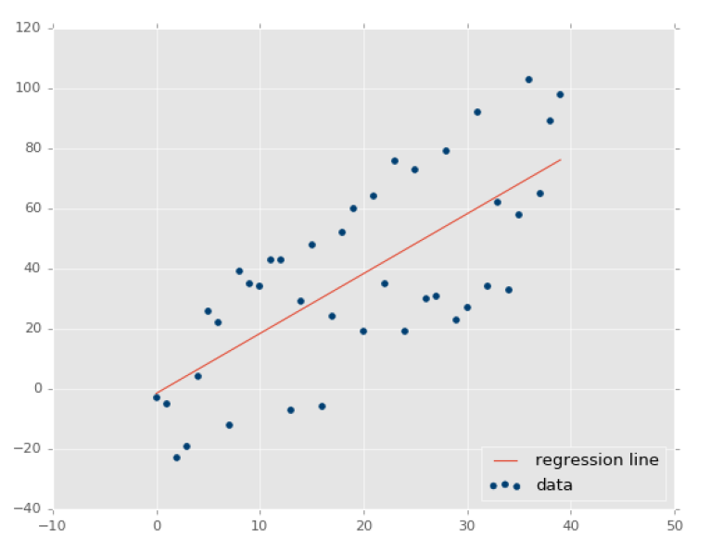
Linear Regression
error

Slide 12
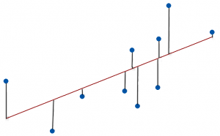

Slide 13

Mean Absolute Error (MAE)
A measure of errors between paired observations expressing the same phenomenon
Less sensitive to outliers
Many small errors = one large error
Best 0th order baseline

Slide 14
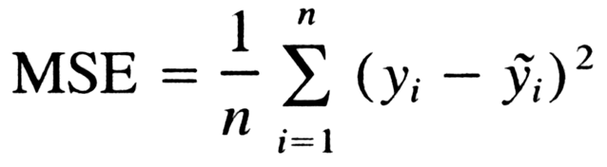
Mean Square Error (MSE)
How close a regression line is to a set of points
Square value aims to remove any negative signs
Give more weight to larger differences.
Notes:
https://youtu.be/iEDClBCOnnM

Slide 15
Gradient descent
To find the coefficients that minimize our error function we will use gradient descent.
Gradient descent is an optimization algorithm which iteratively takes steps to the local minimum of the cost function, i.e., to reduce the cost function.
Learning rate controls how much we should adjust the weights with respect to the loss gradient.

Slide 16
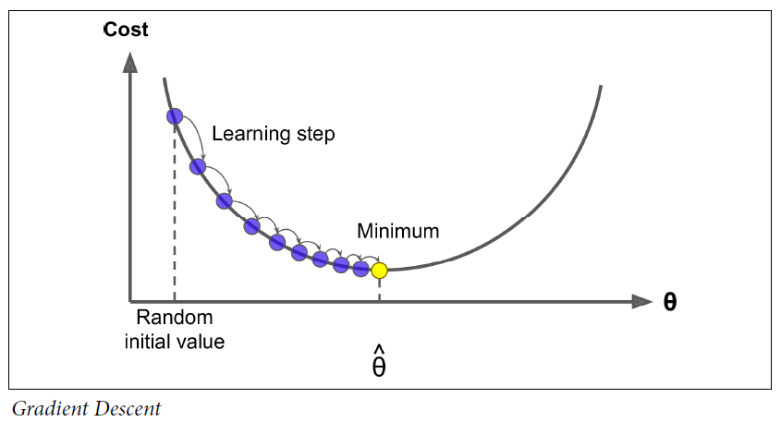
Gradient descent

Slide 17
Multiple Linear Regression
Linear regression is called multivariate if you are working with at least two independent variables.
Each of the independent variables also called features gets multiplied with a weight which is learned by our linear regression algorithm.

Slide 18
Logistic Regression
Logistic regression is a model that uses a logistic function to model a dependent variable.
Like all regression analyses, the logistic regression is a predictive analysis.
Logistic regression is used to describe data and to explain the relationship between one dependent variable and one or more independent variables.

Slide 19
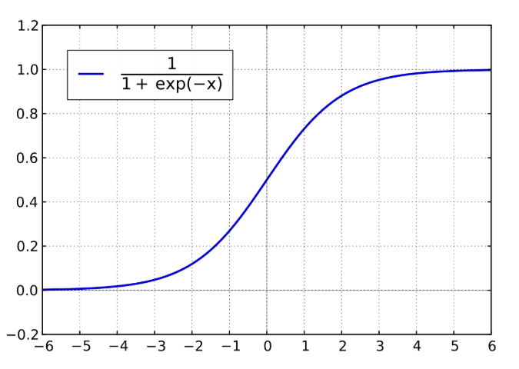
Logistic Function

Slide 20
Applications
Forecasting or Predictive analysis − One of the important uses of regression is forecasting or predictive analysis. For example, we can forecast GDP, oil prices or in simple words the quantitative data that changes with the passage of time.
Optimization − We can optimize business processes with the help of regression. For example, a store manager can create a statistical model to understand the peek time of coming of customers.
Error correction − In business, taking correct decision is equally important as optimizing the business process. Regression can help us to take correct decision as well in correcting the already implemented decision.
Economics − It is the most used tool in economics. We can use regression to predict supply, demand, consumption, inventory investment etc.
Finance − A financial company is always interested in minimizing the risk portfolio and want to know the factors that affects the customers. All these can be predicted with the help of regression model.

Slide 21
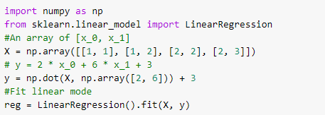

Linear regression in sklearn

Slide 22



Linear regression in sklearn

Slide 23
Unsupervised Learning
Unsupervised learning is a machine learning technique, where you do not need to supervise the model.
The data is unlabeled: we have the input features X, but we do not have the labels y.
Allow the model to work on its own to discover information.

Slide 24
Unsupervised Learning
Unsupervised learning algorithms allows you to perform more complex processing tasks compared to supervised learning.
Although, unsupervised learning can be more unpredictable compared with other natural learning methods.

Slide 25
Why Unsupervised Learning?
Unsupervised machine learning finds all kind of unknown patterns in data.
Unsupervised methods help you find features which can be useful for categorization.
It is taken place in real time, so all the input data to be analyzed and labeled in the presence of learners.
It is easier to get unlabeled data from a computer than labeled data, which needs manual intervention.

Slide 26
Supervised vs Unsupervised
Parameters | Supervised machine learning technique | Unsupervised machine learning technique
Input Data | Algorithms are trained using labeled data. | Algorithms are used against data which is not labelled.
Computational Complexity | Supervised learning is a simpler method. | Unsupervised learning is computationally complex.
Accuracy | Highly accurate and trustworthy method. | Less accurate and trustworthy method.

Slide 27
Types of Unsupervised Learning
Unsupervised learning problems are grouped into clustering and association problems.
Clustering is an important concept when it comes to unsupervised learning.
It mainly deals with finding a structure or pattern in a collection of uncategorized data.
Clustering algorithms will process your data and find natural clusters (groups) if they exist in the data.

Slide 28
Types of Unsupervised Learning
You can also modify how many clusters your algorithms should identify.
It allows you to adjust the granularity of these groups.
Association rules allow you to establish associations amongst data objects inside large databases.
This unsupervised technique is about discovering interesting relationships between variables in large databases.

Slide 29
Types of Unsupervised Learning
For example, people that buy a new home most likely to buy new furniture.
Other examples include:
A subgroup of cancer patients grouped by their gene expression measurements
Groups of shopper based on their browsing and purchasing histories
Movie group by the rating given by movies viewers

Slide 30
Disadvantages of Unsupervised Learning
You cannot get precise information regarding data sorting, and the output as data used in unsupervised learning is labeled and not known
Less accuracy of the results is because the input data is not known and not labeled by people in advance.
This means that the machine requires to do this itself.
The spectral classes do not always correspond to informational classes.
The user needs to spend time interpreting and label the classes which follow that classification.
Spectral properties of classes can also change over time so you can't have the same class information while moving from one image to another.

Slide 31
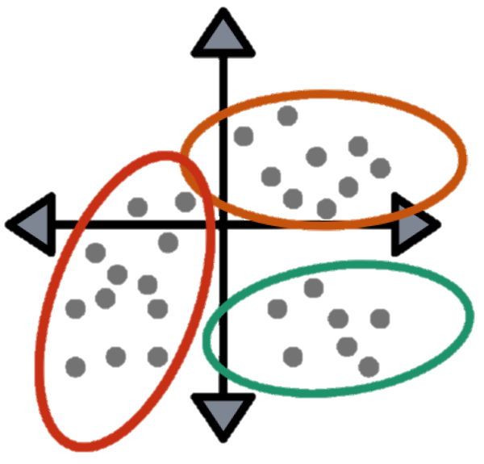
Introduction to Clustering
What is Clustering?
The Goal of Clustering
Proximity Measures
Applications of Clustering
Types of Clustering

Slide 32
What is Clustering?
Clustering can be considered the most important unsupervised learning problem.
It deals with finding a structure in a collection of unlabeled data.
A loose definition of clustering could be “the process of organizing objects into groups whose members are similar in some way”.
A cluster is therefore a collection of objects which are “similar” between them and are “dissimilar” to the objects belonging to other clusters.

Slide 33
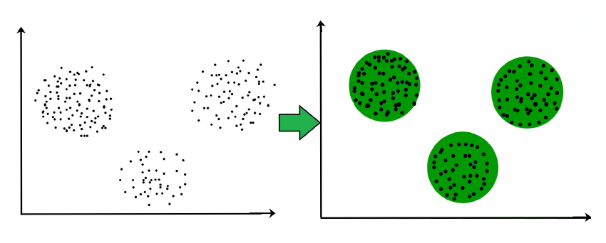
What is Clustering? (2)

Slide 34
The Goal of Clustering
The goal of clustering is to determine the internal grouping in a set of unlabeled data.
But how to decide what constitutes a good clustering?
It can be shown that there is no absolute “best” criterion which would be independent of the final aim of the clustering.
To find a particular clustering solution , we need to define the similarity measures for the clusters.

Slide 35
Proximity Measures
For clustering, we need to define a proximity measure for two data points.
Proximity here means how similar/dissimilar the samples are with respect to each other.
Similarity measure S(xi, xk): large if xi, xk are similar.
Dissimilarity (or distance) measure D(xi, xk): small if xi, xk are similar.

Slide 36
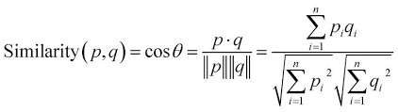
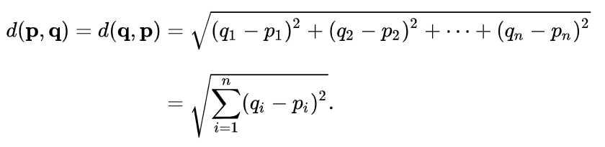
Proximity Measures
There are various similarity measures:
Vectors: Cosine Distance
Points: Euclidean Distance

Slide 37
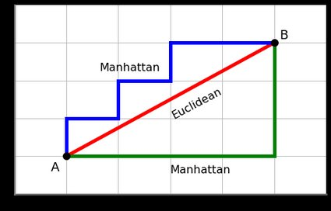
Manhattan Distance vs Euclidean Distance

Slide 38
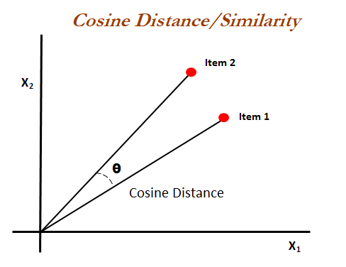
Cosine Similarity & Distance

Slide 39
Applications of Clustering
Marketing : It can be used to characterize & discover customer segments for marketing purposes.
Biology : It can be used for classification among different species of plants and animals.
Libraries : It is used in clustering different books on the basis of topics and information.
Insurance : It is used to acknowledge the customers, their policies and identifying the frauds.

Slide 40
Applications of Clustering
City Planning : It is used to make groups of houses and to study their values based on their geographical locations and other factors present.
Earthquake studies : By learning the earthquake-affected areas we can determine the dangerous zones.

Slide 41
Types of Clustering
1. Exclusive (Partitioning)
In this clustering method, Data are grouped in such a way that one data can belong to one cluster only.
Example: K-means
2. Agglomerative (Single Linkage Clustering)
In this clustering technique, every data is a cluster.
The iterative unions between the two nearest clusters reduce the number of clusters.
Example: Hierarchical clustering

Slide 42
Types of Clustering
3. Probabilistic (Expectation-Maximization)
This technique uses probability distribution to create the clusters.
Example: Following keywords, "man's shoe", "women's shoe", "women's glove", "man's glove“ can be clustered into two categories "shoe" and "glove" or "man" and "women.“
Example: Gaussian Mixture Model (GMM)

Slide 43
Hierarchal Clustering: An Example(1)
Given a dataset of following points: (1, 1), (1, 2), (2, 4), (5,2), (7, 1), (7, 3), please conduct a hierarchical clustering (bottom-up) and write down your steps. In each step, please specify the number of clusters, points in each cluster, and centroid of each cluster.

Slide 44
Hierarchal Clustering: An Example(2)
Initially, each data point is a single cluster.
Initially, all data points are centroids.
How to determine the “nearness” of the clusters?
Measure cluster distances by distances of centroids
How to determine the centroid after two clusters merge?
Use their mid point as the new centroid.

Slide 45
Hierarchal Clustering: An Example(3)
Step 1: Initialize all the centroids of cluster.
centroids | (1, 1) | (1, 2) | (2, 4) | (5, 2) | (7, 1) | (7, 3)

Slide 46
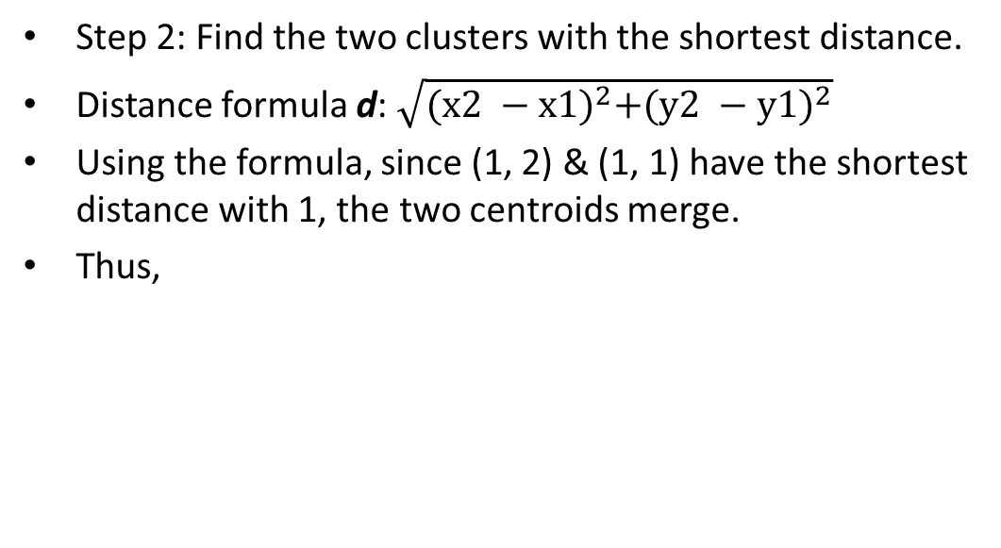
Hierarchal Clustering: An Example(4)
Step 2: Find the two clusters with the shortest distance.
Distance formula d: $\sqrt{{(x2 −x1)}^{2}+{(y2 −y1)}^{2}}$
Using the formula, since (1, 2) & (1, 1) have the shortest distance with 1, the two centroids merge.
Thus,
 | (1, 1), (1, 2) | (2, 4) | (5, 2) | (7, 1) | (7, 3)
centroids | (1, 3/2) | (2, 4) | (5, 2) | (7, 1) | (7, 3)

Slide 47
Hierarchal Clustering: An Example(5)
Step 3~N: Find the two clusters with the shortest distance until there is one cluster left.
 | (1, 1), (1, 2) | (2, 4) | (5, 2) | (7, 1), (7, 3)
centroids | (1, 3/2) | (2, 4) | (5, 2) | (7, 2)

Slide 48
Hierarchal Clustering: An Example(6)
Step 3~N: Find the two clusters with the shortest distance until there is one cluster left.
 | (1, 1), (1, 2) | (2, 4) | (5, 2), (7, 1), (7, 3)
centroids | (1, 3/2) | (2, 4) | (19/3, 2)

Slide 49
Hierarchal Clustering: An Example(7)
Step 3~N: Find the two clusters with the shortest distance until there is one cluster left.
 | (1, 1), (1, 2), (2, 4) | (5, 2), (7, 1), (7, 3)
centroids | (4/3 , 7/3) | (19/3, 2)

Slide 50
Hierarchal Clustering: An Example(8)
1 cluster
We can say that after the process of hierarchal clustering, the centroid of the cluster is (23/6, 13/6).
 | (1, 1), (1, 2), (2, 4), (5, 2), (7, 1), (7, 3)
centroid | (23/6 , 13/6)

Slide 51
Clustering Algorithms in Scikit-Learn
Partitioning – K-means
Single Linkage Clustering (SLC)
Expectation Maximization (EM)

Slide 52
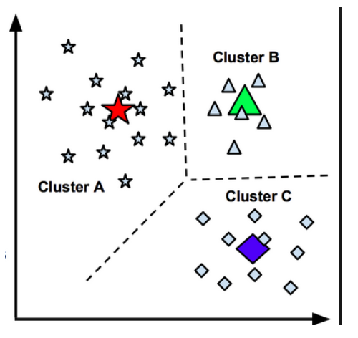
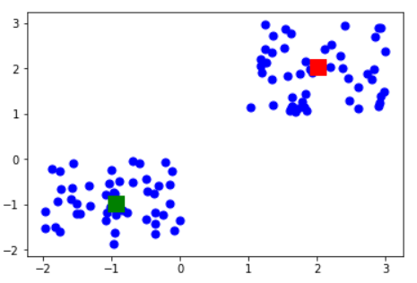
Partitioning – K-means
K-means clustering is an iterative algorithm that partitions a group of data containing n values into k subgroups.
Each of the n value belongs to the k cluster with the nearest mean.

Slide 53
Partitioning – K-means
Algorithm for K-means Clustering
First, we randomly initialize and select the k-points. These k-points are the means.
We use the Euclidean distance to find data-points that are closest to their centroid of the cluster.
Then we calculate the mean of all the points in the cluster which is finding their centroid.
We iteratively repeat step 1, 2 and 3 until all the centroids remain unchanged.

Slide 54
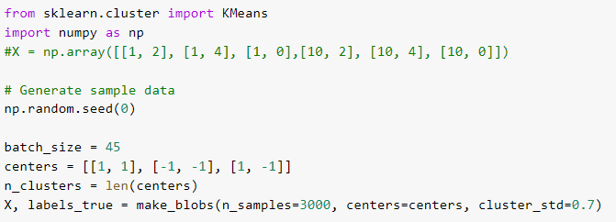

K-means in sklearn

Slide 55


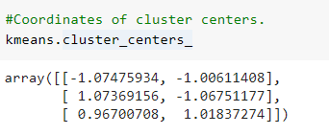
K-means in sklearn

Slide 56
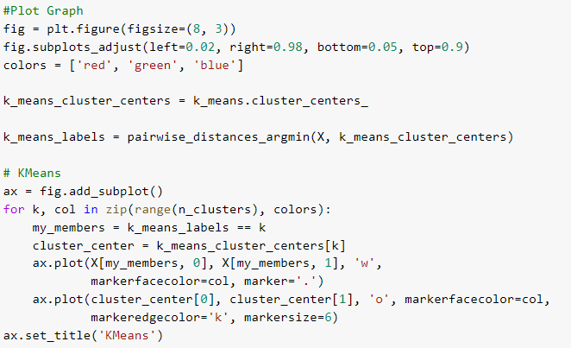
K-means in sklearn

Slide 57
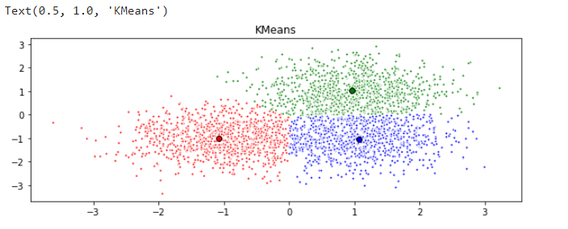
K-means in sklearn

Slide 58
Single Linkage Clustering (SLC)
This algorithm has a “hierarchical agglomerative cluster structure” as it “links” each point of the dataset to one another and therefore separates them in different clusters.
Hierarchical clustering is used to cluster unlabeled data points.
Like K-means clustering, hierarchical clustering also groups together the data points with similar characteristics.
In some cases the result of hierarchical and K-Means clustering can be similar.

Slide 59
Single Linkage Clustering
There are two types of hierarchical clustering: Agglomerative and Divisive.
In the former, data points are clustered using a bottom-up approach starting with individual data points.
Divisive is a top-down approach where all the data points are treated as one big cluster and the clustering process involves dividing the one big cluster into several small clusters.
Here we will focus on agglomerative clustering that involves the bottom-up approach.

Slide 60
Single Linkage Clustering
Algorithm for Hierarchical Clustering
Consider each object as a cluster (there will be n clusters for n objects).
Form a cluster by joining the two closest data points resulting in n-1 clusters.
Form more clusters by joining the two closest clusters resulting in n-2 clusters.
Repeat the above three steps until one big cluster is formed.

Slide 61
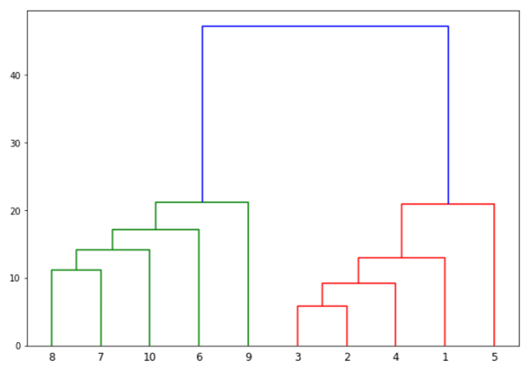
Single Linkage Clustering
Dendrogram

Slide 62
Single Linkage Clustering
Algorithm for Hierarchical Clustering
Consider each object as a cluster (there will be n clusters for n objects).
Form a cluster by joining the two closest data points resulting in n-1 clusters.
Form more clusters by joining the two closest clusters resulting in n-2 clusters.
Repeat the above three steps until one big cluster is formed.

Slide 63
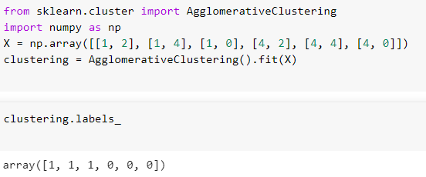
Hierarchical Clustering in sklearn

Slide 64
Expectation Maximization (EM)
Clustering is an essential part of any data analysis. Using an algorithm such as K-means leads to hard assignments, meaning that each point is definitively assigned a cluster center.
This leads to some interesting problems: what if the true clusters actually overlap?
What about data that is more spread out; how do we assign clusters then?

Slide 65
Expectation Maximization
Gaussian Mixture Models save the day!
Training these models requires using a very famous algorithm called the Expectation Maximization Algorithm.
This algorithm is a soft clustering, which uses probability to make that point as “shared” between the two clusters.

Slide 66
Expectation Maximization
While k-mean is doing a deterministic assignment of the data, EM is instead using a probabilistic approach.
This algorithm iterates two steps, defined by estimation and maximization.
The estimation step finds the likelihood that a data “i” comes from a cluster “j”.
The maximization step uses this “expected” model and maximizes it to find the data fits.

Slide 67
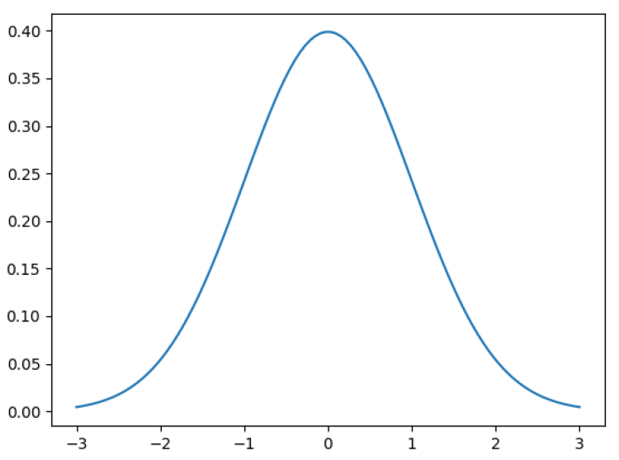
Expectation Maximization
Gaussian Distribution is the most famous and important of all statistical distributions.
Here’s an example of a Gaussian centered (mean) at 0 with a standard deviation of 1.

Slide 68
Expectation Maximization
There is a famous theorem in statistics called the Central Limit Theorem that states that enough random samples from any distribution tend to resemble a normal (Gaussian) distribution.
This makes Gaussian very powerful and versatile!

Slide 69
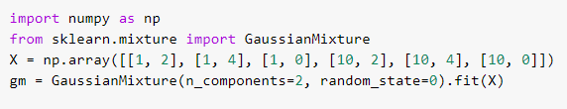
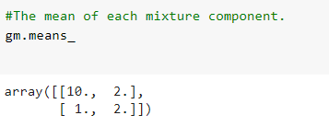

Gaussian Mixture in sklearn

Slide 70

Self Study Guide

Slide 71
Self Study Guide
References
Müller, A.C. & Guido, S. (2016). Introduction to Machine Learning with Python: A Guide for Data Scientists (1st ed.). Sebastopol, CA: O’Reilly.
Géron, A. (2017). Hands-On Machine Learning with Scikit-Learn and TensorFlow: Concepts, Tools, and Techniques to Build Intelligent Systems (1st ed.). Sebastopol, CA: O’Reilly.
Useful Sites
https://scikit-learn.org

